Slide 1
Competitive Cyber Security Organization
Red Team Open House – AMSI Almost Bypass
By attending today’s meeting you acknowledge that you may be photographed or recorded for club use
balls

Slide 2
Learning Objectives:
Learn what Antimalware Scan Interface (ASMI) is and how it works
Understand AMSI Bypass techniques from varying levels of complexity
Comprehend the pros and cons of each technique
Apply it yourself!

Slide 3
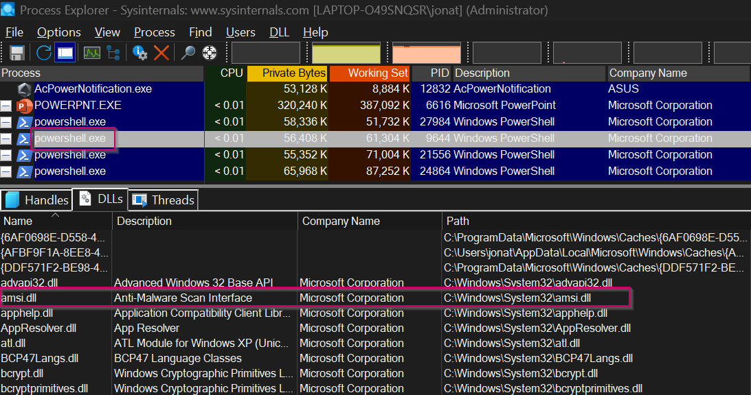
What is ASMI???
Antimalware API usually called by C:\Windows\System32\amsi.dll
Scans executed script at runtime using AmsiScanBuffer() and AmsiScanString() functions
Where is AMSI Integrated?:
User Access Control
Powershell
JavaScript or VBscript
Office VBA macros
WMI & .NET

Slide 4
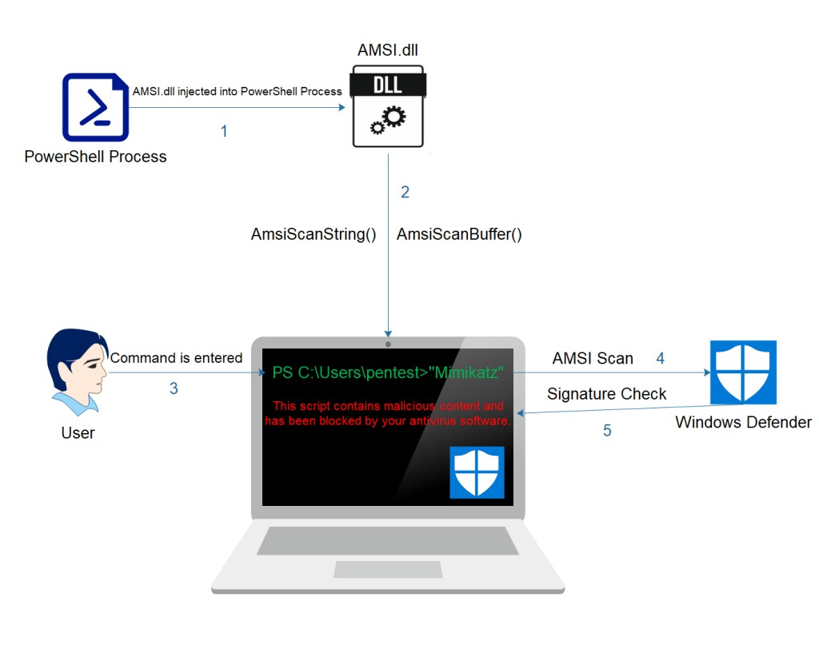
How does AMSI Work?
Eight Functions:
AsmiInitialize
AsmiOpenSession
AsmiScanBuffer/AsmiScanString
AsmiResultsIsMalware
AsmiNotifyOperation
AsmiCloseSession
AsmiUninitialize

Slide 5
Most Common Bypass Tehcniques
Powershell Downgrade
Obfuscation
Error Forcing
Memory Patching
DLL Sideloading/Hijack

Slide 6
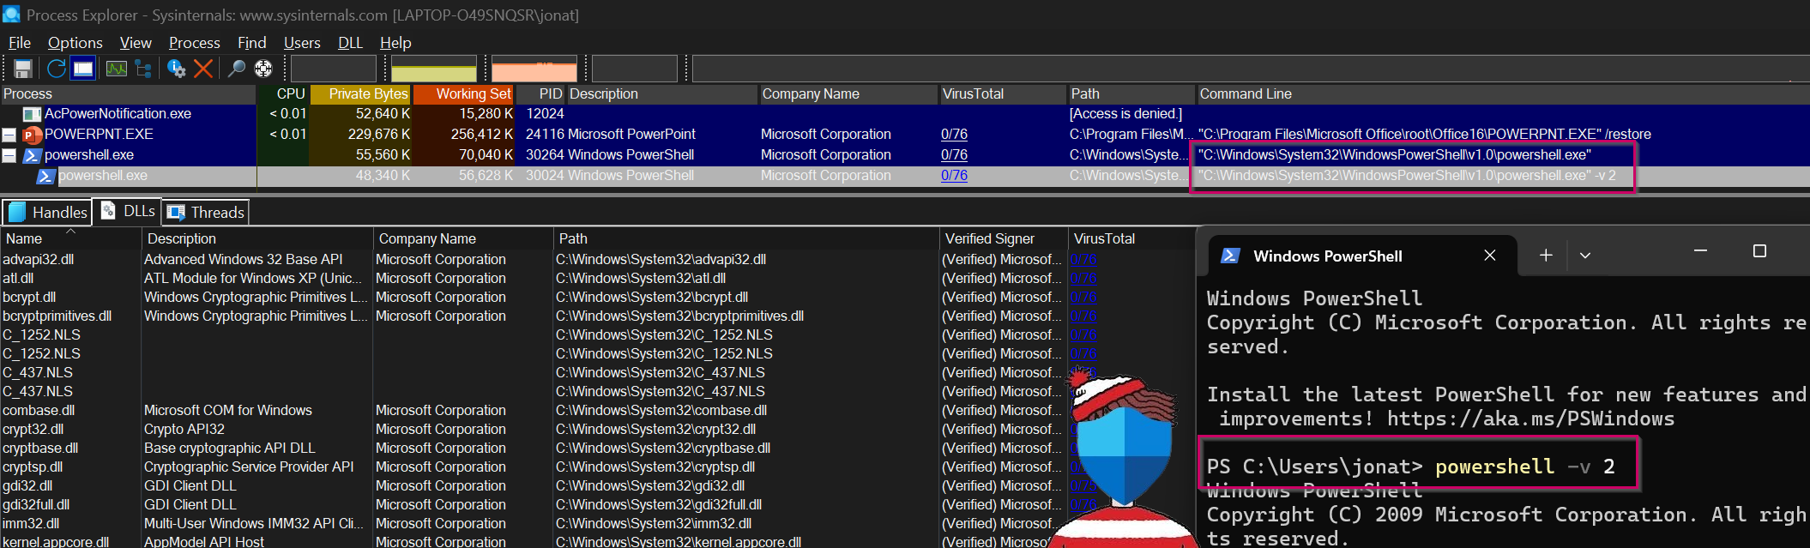
Powershell Downgrade
Where’s AMSI?
AMSI Introduced in Powershell V3 (2012)
Extremely Outdated
Easily Detectable & Can Be Circumvented
Useful in a Pinch

Slide 7
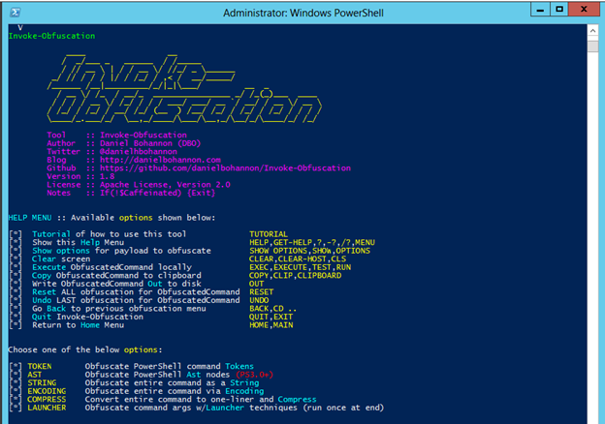
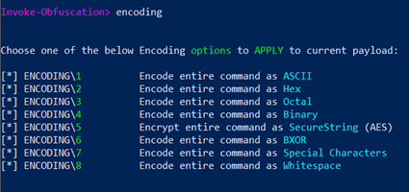
Obfuscation
Base64, Concatenation, and Variable Setting
Potential to Break Scripts
Varying levels of complexity
Can be used at specific breakpoints (AMSITrigger)
balls

Slide 8
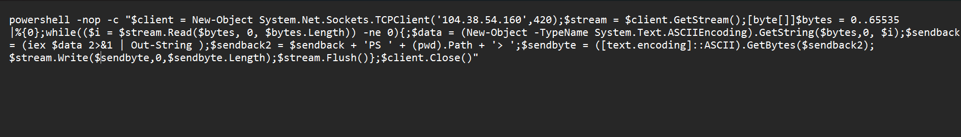
Obfuscation
balls

Slide 9
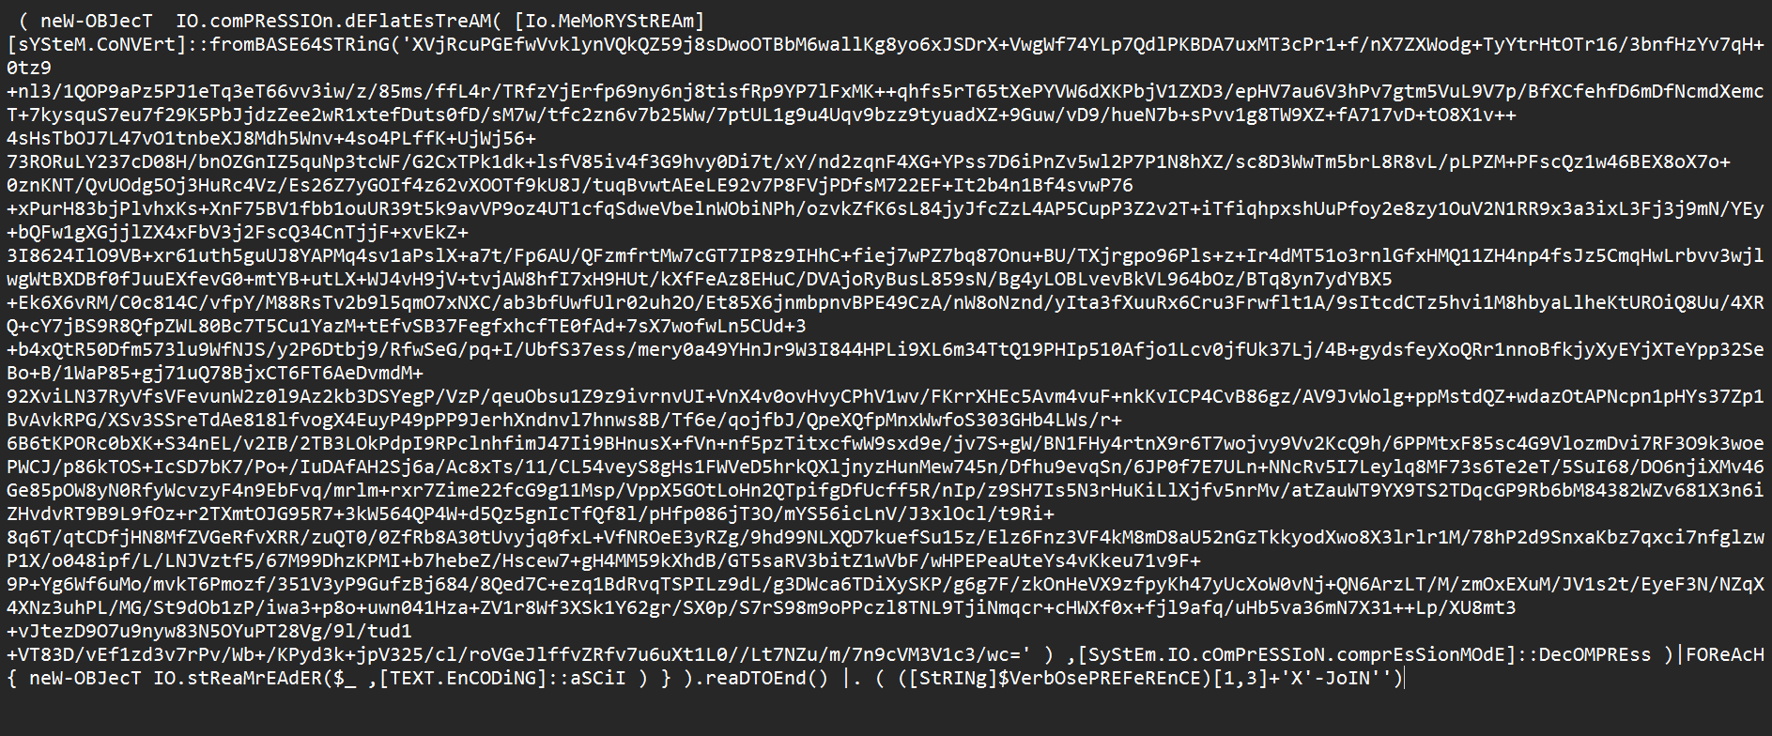
Obfuscation
balls

Slide 10
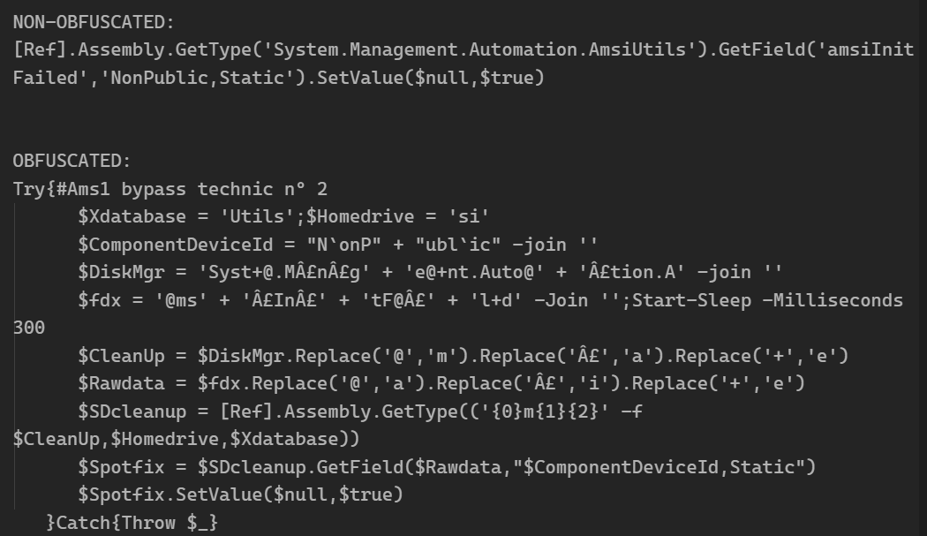
Error Forcing
Attacks the functions called from asmi.dll
“Breaking the Logic”
amsiInitFailed & amsiContext
…

Slide 11
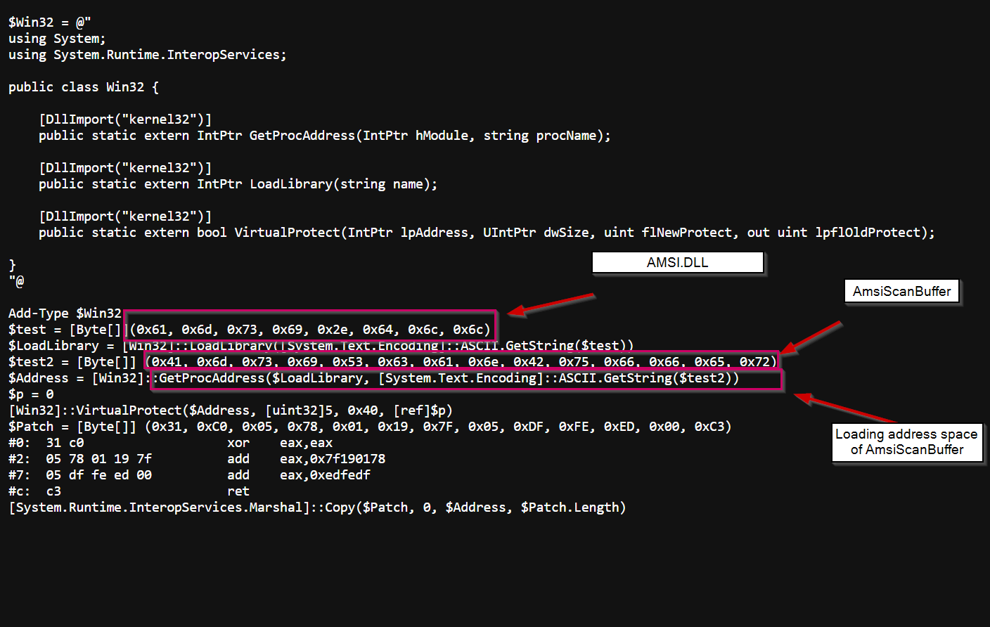
Memory Patching
Similar to Error Forcing
Overwrites the whole function
AmsiScanBuffer() always returns AMSI_RESULT_CLEAN

Slide 12
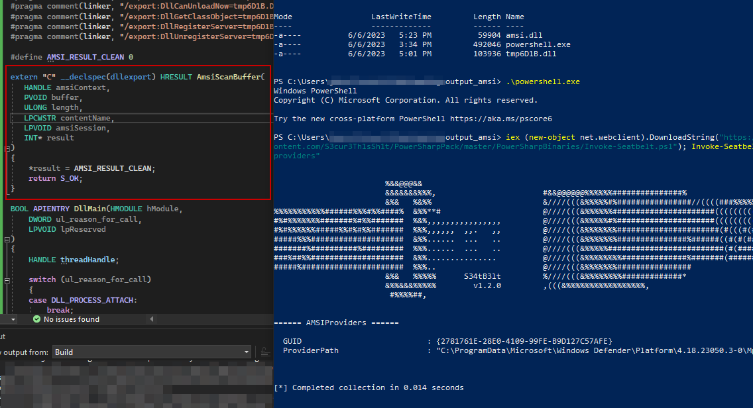
DLL Sideloading
Create & Displace amsi.dll file
DLL Search Order
The folder the application is launched out of
C:\Windows\System32\
C:\Windows\system\
C:\Windows\
balls

